Slide 1
Chapter 18
Methodology – Physical Database Design for Relational Databases
Pearson Education © 2009

Slide 2
Chapter 18 - Objectives
Purpose of physical database design.
How to map the logical database design to a physical database design.
How to design base relations for target DBMS.
How to design general constraints for target DBMS.
Pearson Education © 2009

Slide 3
Chapter 18 - Objectives
How to select appropriate file organizations based on analysis of transactions.
When to use secondary indexes to improve performance.
How to estimate the size of the database.
How to design user views.
How to design security mechanisms to satisfy user requirements.
Pearson Education © 2009

Slide 4
Logical v. Physical Database Design
Sources of information for physical design process includes logical data model and documentation that describes model.
Logical database design is concerned with the what, physical database design is concerned with the how.
Pearson Education © 2009

Slide 5
Physical Database Design
Process of producing a description of the implementation of the database on secondary storage.
It describes the base relations, file organizations, and indexes used to achieve efficient access to the data, and any associated integrity constraints and security measures.
Pearson Education © 2009

Slide 6
Overview of Physical Database Design Methodology
Step 3 Translate logical data model for target DBMS
Step 3.1 Design base relations
Step 3.2 Design representation of derived data
Step 3.3 Design general constraints
Pearson Education © 2009

Slide 7
Overview of Physical Database Design Methodology
Step 4 Design file organizations and indexes
Step 4.1 Analyze transactions
Step 4.2 Choose file organizations
Step 4.3 Choose indexes
Step 4.4 Estimate disk space requirements
Pearson Education © 2009

Slide 8
Overview of Physical Database Design Methodology
Step 5 Design user views
Step 6 Design security mechanisms
Step 7 Consider the introduction of controlled redundancy
Step 8 Monitor and tune operational system
Pearson Education © 2009

Slide 9
Step 3 Translate Logical Data Model for Target DBMS
To produce a relational database schema from the logical data model that can be implemented in the target DBMS.
Need to know functionality of target DBMS such as how to create base relations and whether the system supports the definition of:
PKs, FKs, and AKs;
required data – i.e. whether system supports NOT NULL;
domains;
relational integrity constraints;
general constraints.
Pearson Education © 2009

Slide 10
Step 3.1 Design base relations
To decide how to represent base relations identified in logical model in target DBMS.
For each relation, need to define:
the name of the relation;
a list of simple attributes in brackets;
the PK and, where appropriate, AKs and FKs.
referential integrity constraints for any FKs identified.
Pearson Education © 2009

Slide 11
Step 3.1 Design base relations
From data dictionary, we have for each attribute:
its domain, consisting of a data type, length, and any constraints on the domain;
an optional default value for the attribute;
whether it can hold nulls;
whether it is derived, and if so, how it should be computed.
Pearson Education © 2009

Slide 12
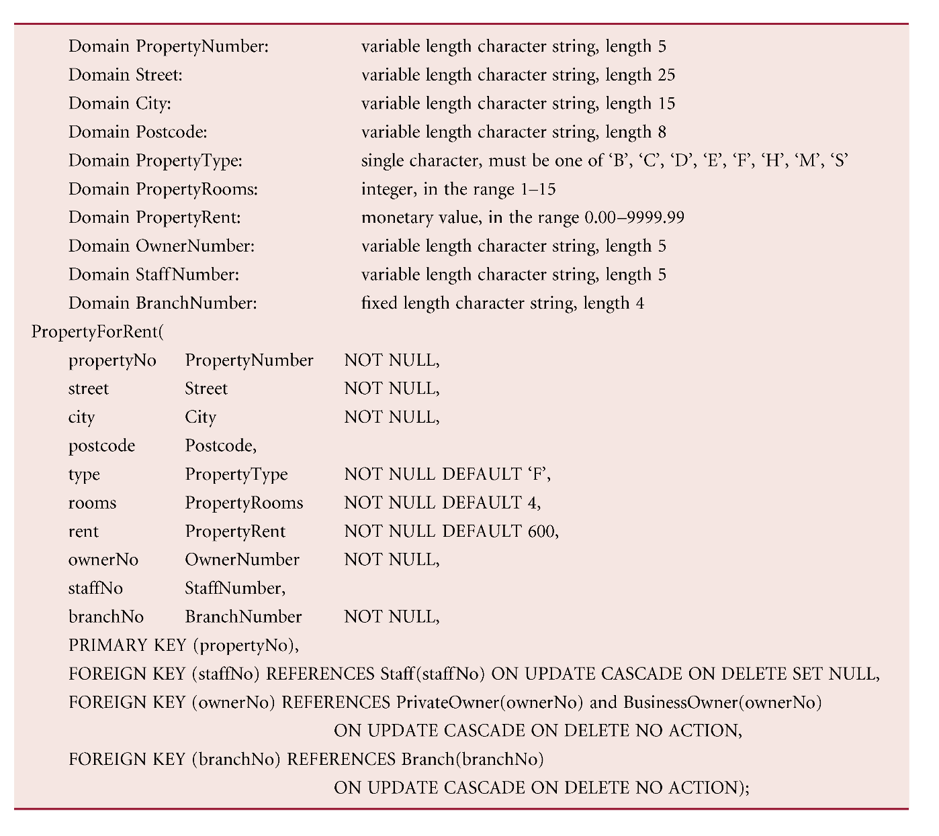
DBDL for the PropertyForRent Relation
Pearson Education © 2009

Slide 13
Step 3.2 Design representation of derived data
To decide how to represent any derived data present in logical data model in target DBMS.
Examine logical data model and data dictionary, and produce list of all derived attributes.
Derived attribute can be stored in database or calculated every time it is needed.
Pearson Education © 2009

Slide 14
Step 3.2 Design representation of derived data
Option selected is based on:
additional cost to store the derived data and keep it consistent with operational data from which it is derived;
cost to calculate it each time it is required.
Less expensive option is chosen subject to performance constraints.
Pearson Education © 2009

Slide 15
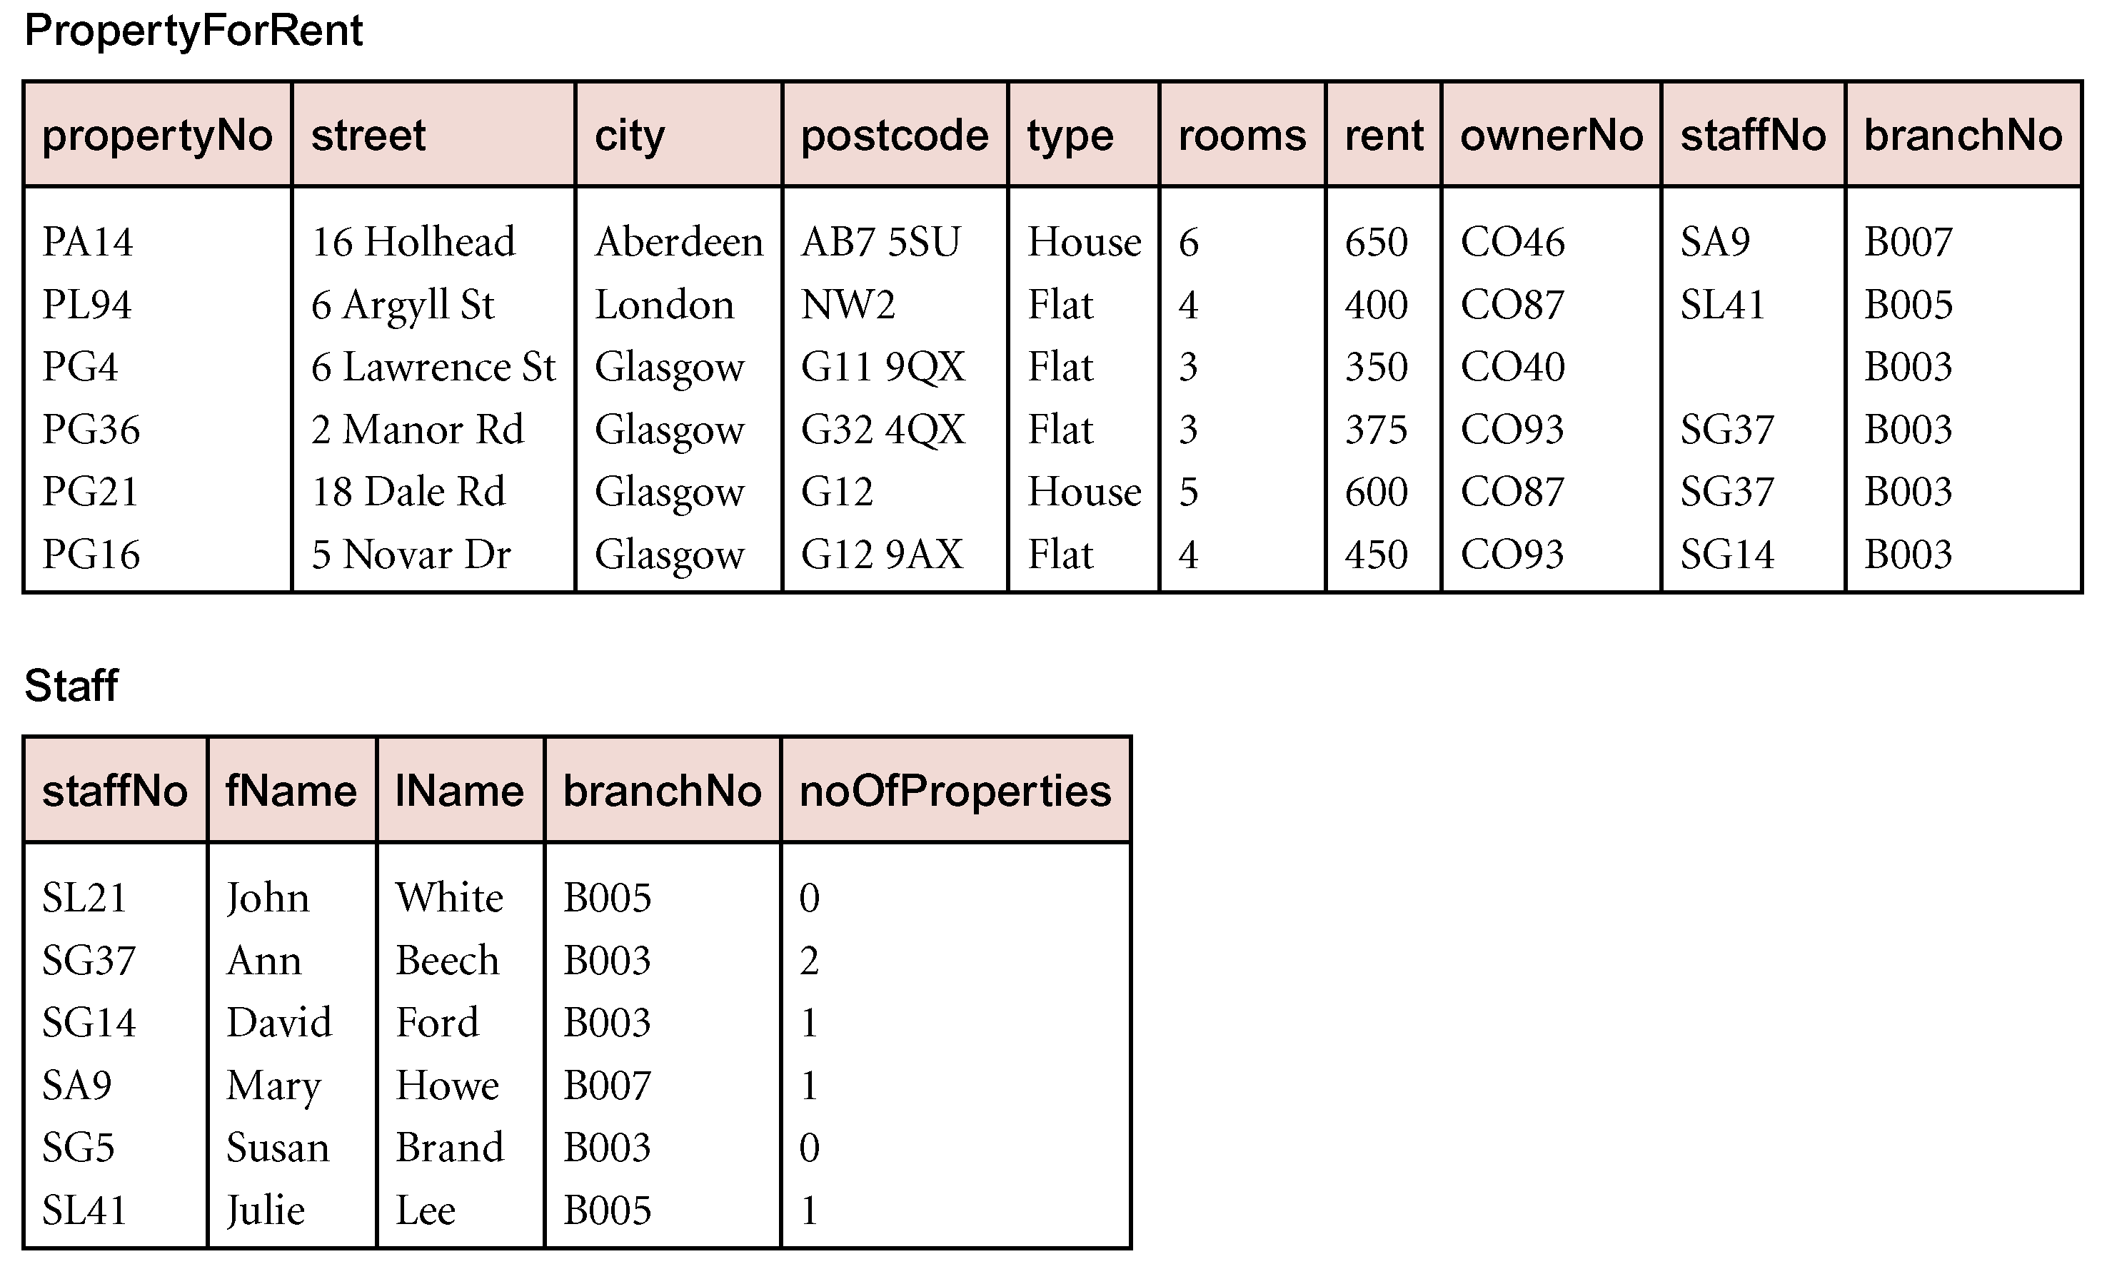
PropertyforRent Relation and Staff Relation with Derived Attribute noOfProperties
Pearson Education © 2009

Slide 16
Step 3.3 Design general constraints
To design the general constraints for target DBMS.
Some DBMS provide more facilities than others for defining enterprise constraints. Example:
CONSTRAINT StaffNotHandlingTooMuch
CHECK (NOT EXISTS (SELECT staffNo
FROM PropertyForRent
GROUP BY staffNo
HAVING COUNT(*) > 100))
Pearson Education © 2009

Slide 17
Step 4 Design File Organizations and Indexes
To determine optimal file organizations to store the base relations and the indexes that are required to achieve acceptable performance; that is, the way in which relations and tuples will be held on secondary storage.
Must understand the typical workload that database must support.
Pearson Education © 2009

Slide 18
Step 4.1 Analyze transactions
To understand the functionality of the transactions that will run on the database and to analyze the important transactions.
Attempt to identify performance criteria, such as:
transactions that run frequently and will have a significant impact on performance;
transactions that are critical to the business;
times during the day/week when there will be a high demand made on the database (called the peak load).
Pearson Education © 2009

Slide 19
Step 4.1 Analyze transactions
Use this information to identify the parts of the database that may cause performance problems.
Also need to know high-level functionality of the transactions, such as:
attributes that are updated;
search criteria used in a query.
Pearson Education © 2009

Slide 20
Step 4.1 Analyze transactions
Often not possible to analyze all transactions, so investigate most ‘important’ ones.
To help identify these can use:
transaction/relation cross-reference matrix, showing relations that each transaction accesses, and/or
transaction usage map, indicating which relations are potentially heavily used.
Pearson Education © 2009

Slide 21
Step 4.1 Analyze transactions
To focus on areas that may be problematic:
(1) Map all transaction paths to relations.
(2) Determine which relations are most frequently accessed by transactions.
(3) Analyze the data usage of selected transactions that involve these relations.
Pearson Education © 2009

Slide 22
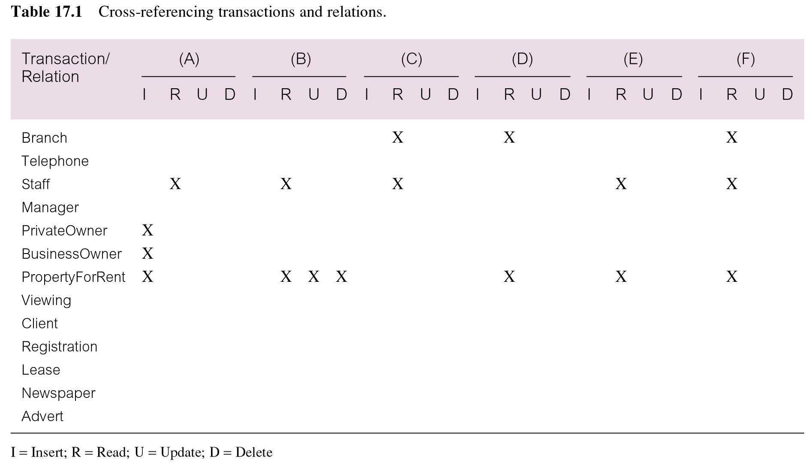
Cross-referencing transactions and relations
Pearson Education © 2009

Slide 23
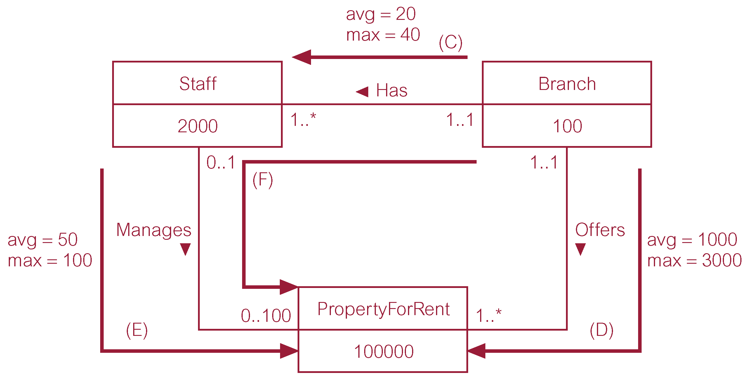
Example Transaction Usage Map
Pearson Education © 2009

Slide 24
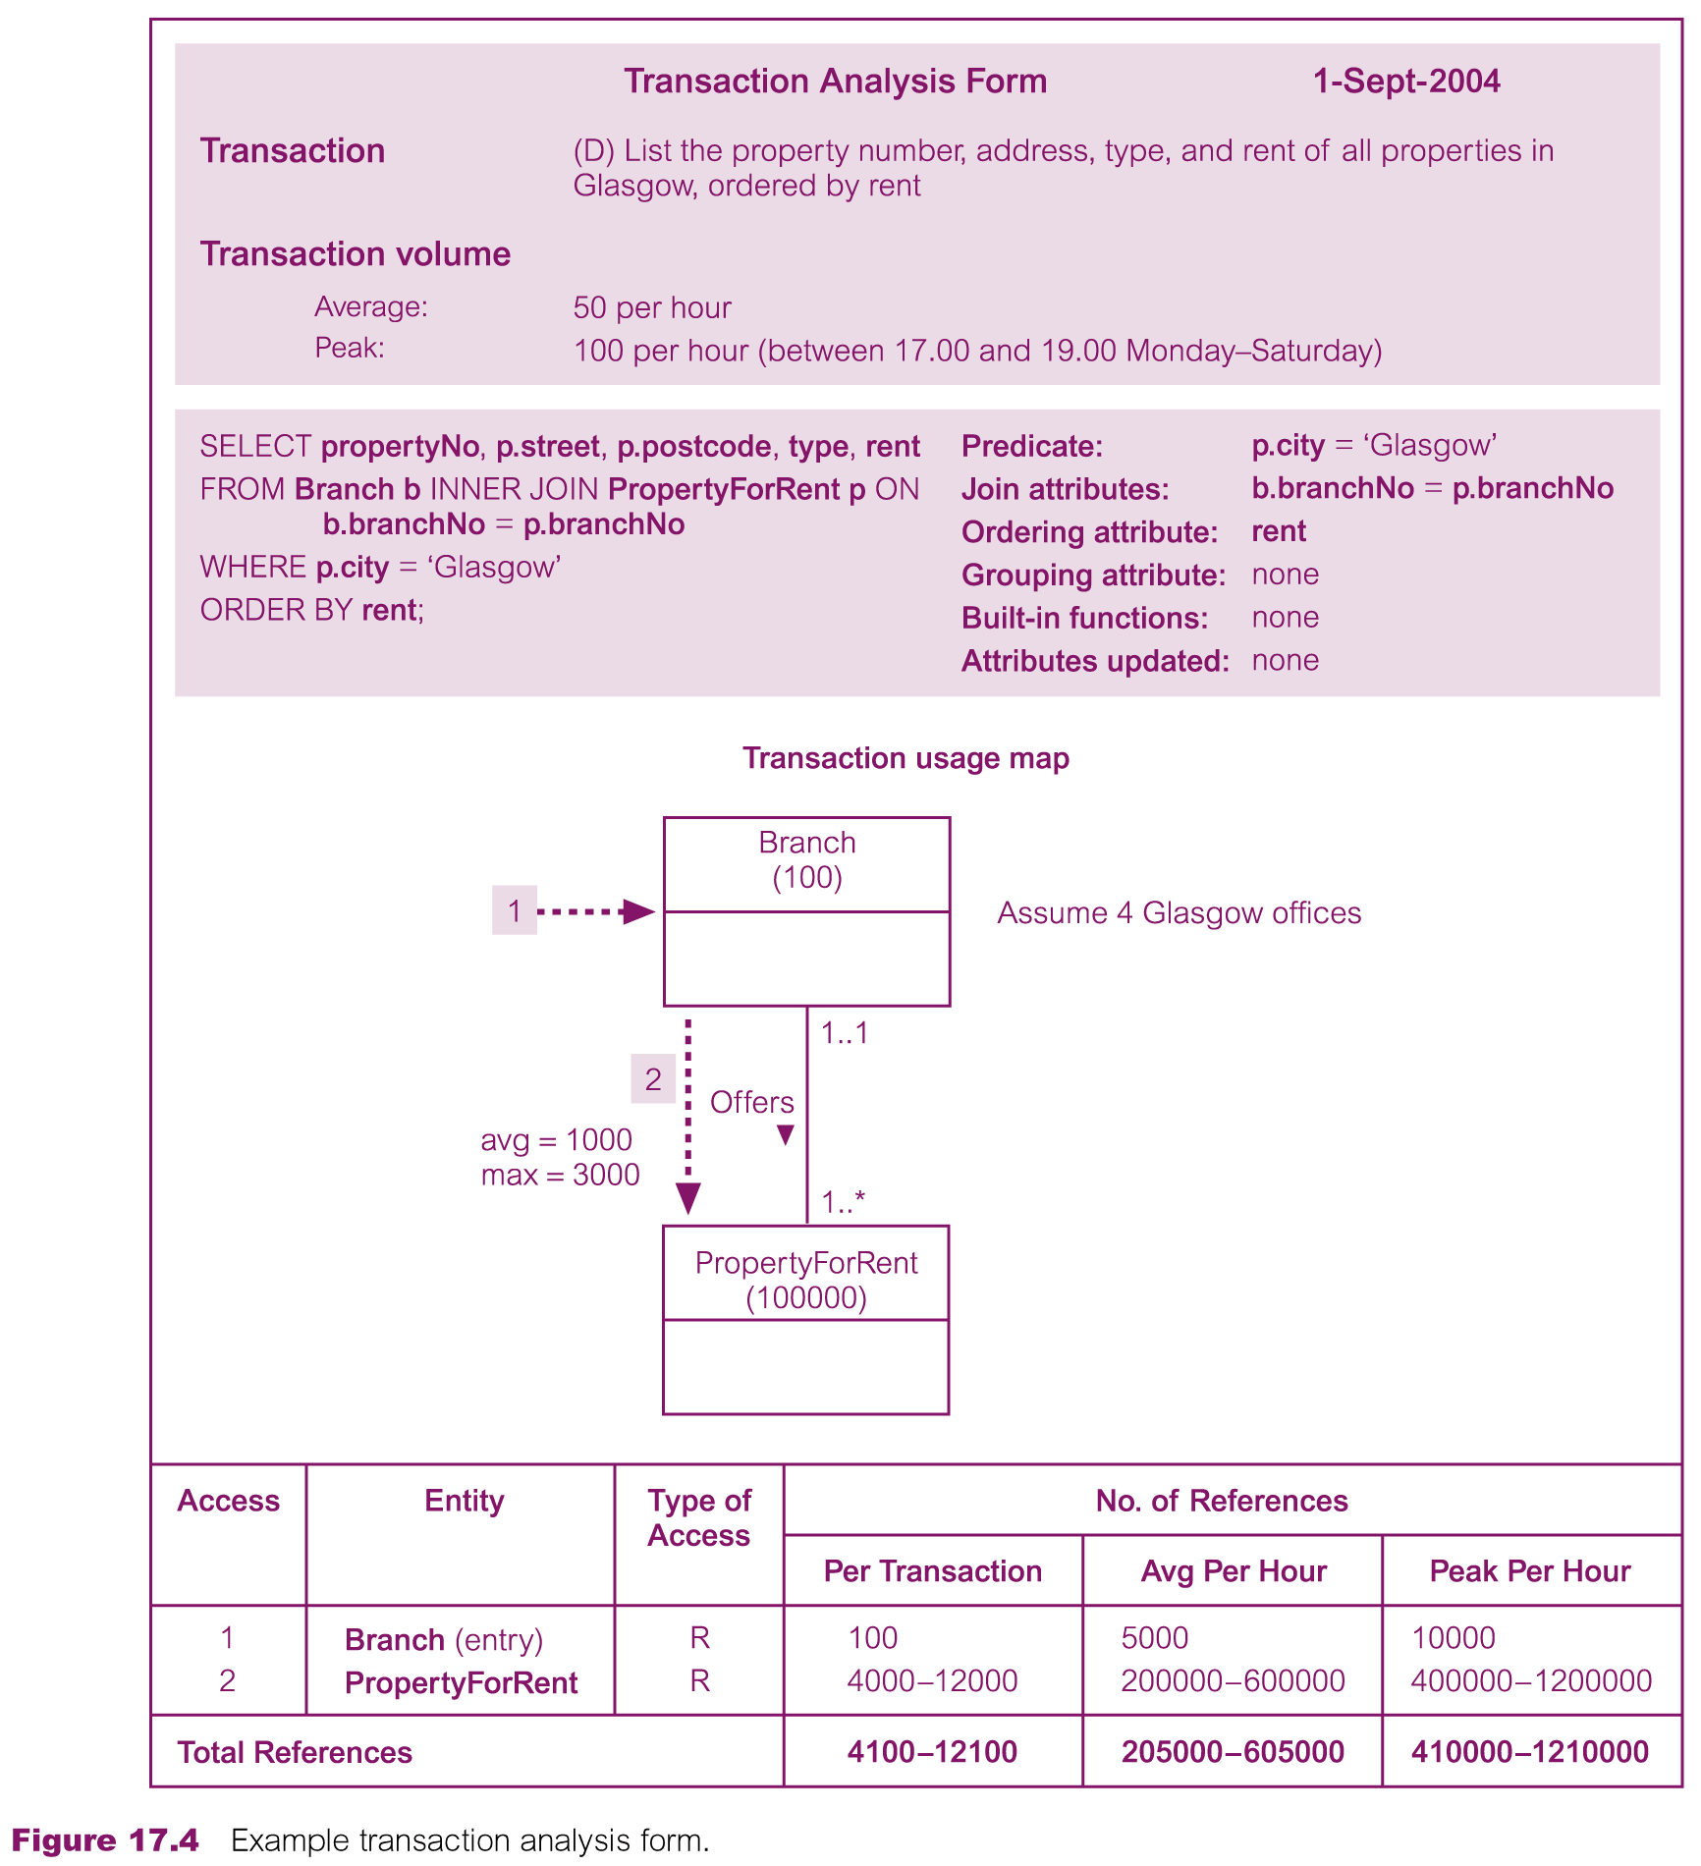
Example Transaction Analysis Form
Pearson Education © 2009

Slide 25
Step 4.2 Choose file organizations
To determine an efficient file organization for each base relation.
File organizations include Heap, Hash, Indexed Sequential Access Method (ISAM), B+-Tree, and Clusters.
Some DBMSs may not allow selection of file organizations.
Pearson Education © 2009

Slide 26
Step 4.3 Choose indexes
To determine whether adding indexes will improve the performance of the system.
One approach is to keep tuples unordered and create as many secondary indexes as necessary.
Pearson Education © 2009

Slide 27
Step 4.3 Choose indexes
Another approach is to order tuples in the relation by specifying a primary or clustering index.
In this case, choose the attribute for ordering or clustering the tuples as:
attribute that is used most often for join operations - this makes join operation more efficient, or
attribute that is used most often to access the tuples in a relation in order of that attribute.
Pearson Education © 2009

Slide 28
Step 4.3 Choose indexes
If ordering attribute chosen is key of relation, index will be a primary index; otherwise, index will be a clustering index.
Each relation can only have either a primary index or a clustering index.
Secondary indexes provide a mechanism for specifying an additional key for a base relation that can be used to retrieve data more efficiently.
Pearson Education © 2009

Slide 29
Step 4.3 Choose indexes
Have to balance overhead involved in maintenance and use of secondary indexes against performance improvement gained when retrieving data.
This includes:
adding an index record to every secondary index whenever tuple is inserted;
updating secondary index when corresponding tuple updated;
increase in disk space needed to store secondary index;
possible performance degradation during query optimization to consider all secondary indexes.
Pearson Education © 2009

Slide 30
Step 4.3 Choose indexes – Guidelines for choosing ‘wish-list’
1. Do not index small relations.
2. Index PK of a relation if it is not a key of the file organization.
3. Add secondary index to a FK if it is frequently accessed.
4. Add secondary index to any attribute heavily used as a secondary key.
5. Add secondary index on attributes involved in: selection or join criteria; ORDER BY; GROUP BY; and other operations involving sorting (such as UNION or DISTINCT).
Pearson Education © 2009

Slide 31
Step 4.3 Choose indexes – Guidelines for choosing ‘wish-list’
6. Add secondary index on attributes involved in built-in functions.
7. Add secondary index on attributes that could result in an index-only plan.
8. Avoid indexing an attribute or relation that is frequently updated.
9. Avoid indexing an attribute if the query will retrieve a significant proportion of the relation.
10. Avoid indexing attributes that consist of long character strings.
Pearson Education © 2009

Slide 32
Step 4.4 Estimate disk space requirements
To estimate the amount of disk space that will be required by the database.
Pearson Education © 2009

Slide 33
Step 5 Design User Views
To design the user views that were identified during the Requirements Collection and Analysis stage of the database system development lifecycle.
Pearson Education © 2009

Slide 34
Step 6 Design Security Measures
To design the security measures for the database as specified by the users.
Pearson Education © 2009

